Slide 1
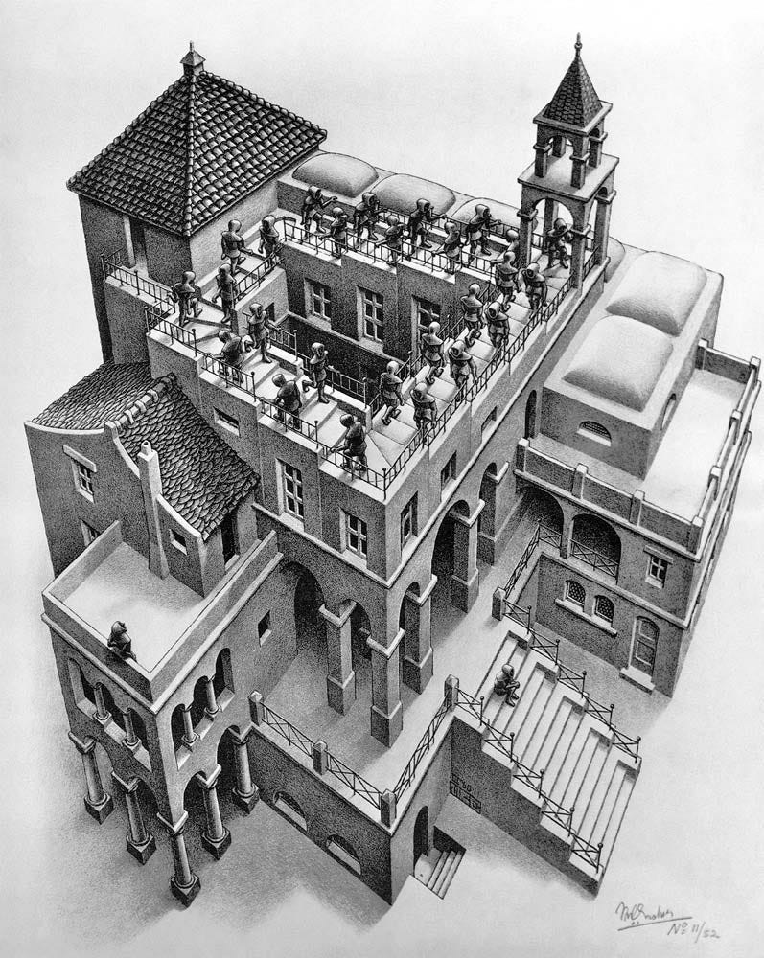
Agenda
Review activity from last class
PRDM9, “Penrose stairs,” and the evolution of the recombination map

Slide 2
PRDM9 and the evolution of the recombination map

Slide 3
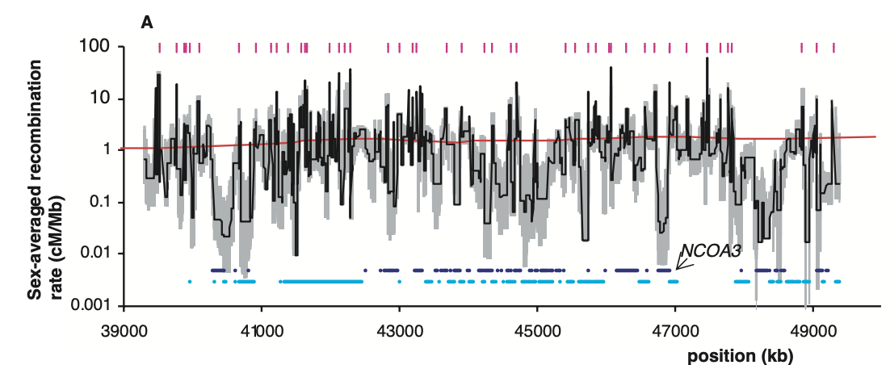
Ubiquitous recombination hotspots in humans
McVean et al. 2004

Slide 4
Enriched hotspot motif: CCTCCCT (Myers et al. 2005)

Slide 5
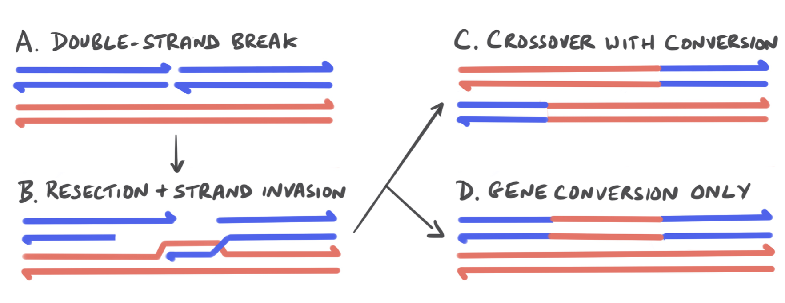
Hotspot paradox: biased gene conversion removes hotspots
Pritchard, 2024

Slide 6
Hotspot paradox: biased gene conversion removes hotspots
A mutation arises and inactivates a hotspot, producing a “cold” allele
In heterozygotes, recombination at that hotspot causes gene conversion
The cold allele is over-transmitted and eventually fixes

Slide 7
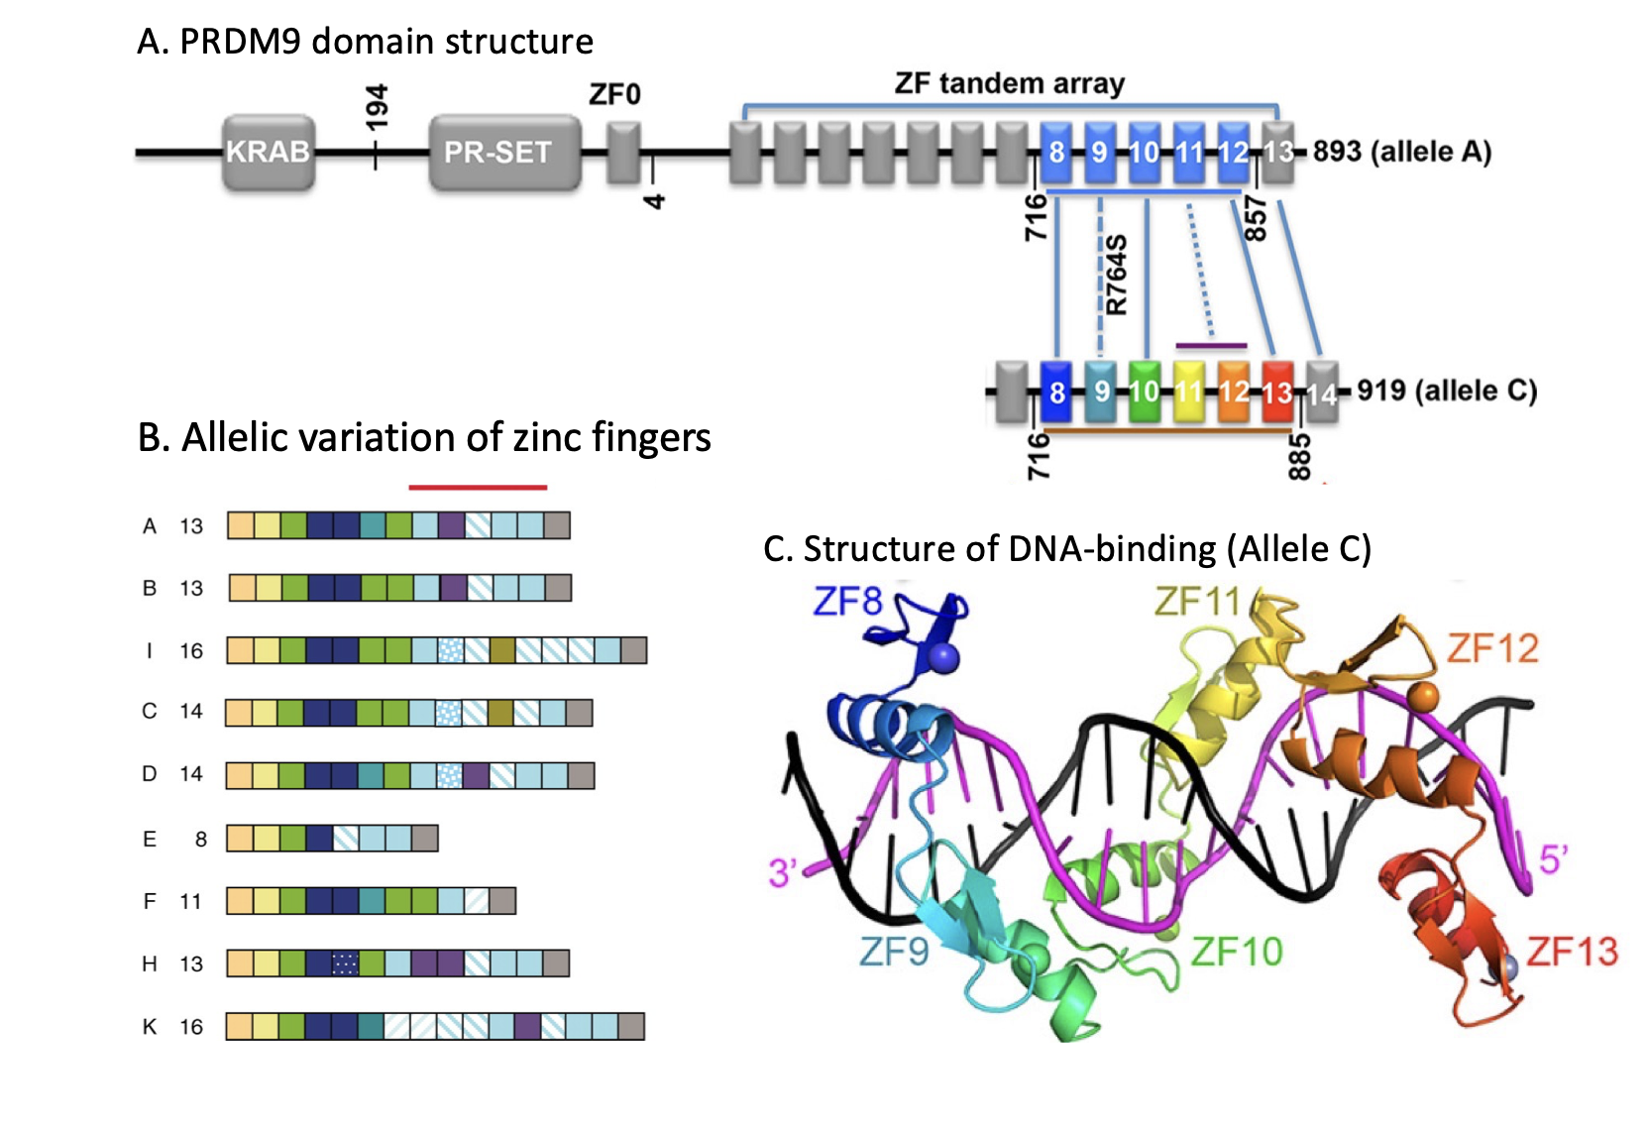
Rapidly evolving binding specificity of PRDM9

Slide 8
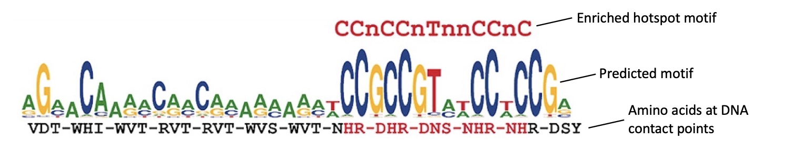
Pritchard 2024, modified from Baudet et al. 2010

Slide 9
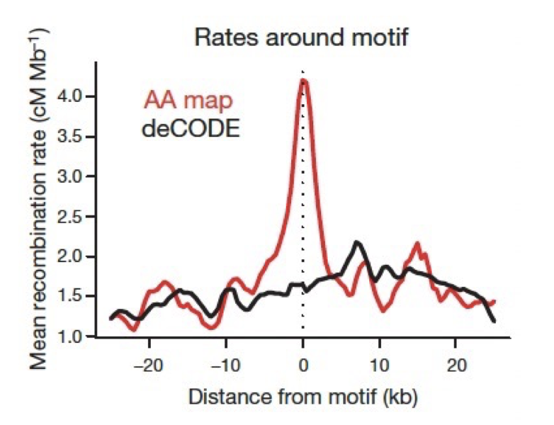
Pritchard 2024, modified from Hinch et al. 2011

Slide 10
Red Queen model: adaptive selection for total PRDM9 binding
Ubeda et al. 2011

Slide 11
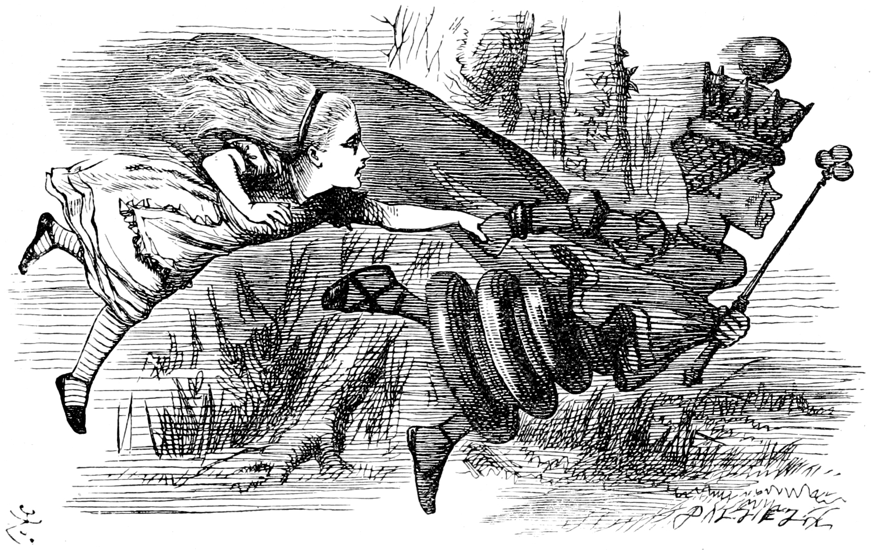
Red Queen model: adaptive selection for total PRDM9 binding
Now, here, you see, it takes all the running you can do, to keep in the same place. –Lewis Carroll
Ubeda et al. 2011

Slide 12
The end?

Slide 13
Problems with the total-binding model
Different alleles lead to the same number of DSBs and recombinations
Loss of PRDM9 affects DSB locations, but crossing over can proceed
Most hotspots: no DSB
Why have hotspots in the first place?

Slide 14
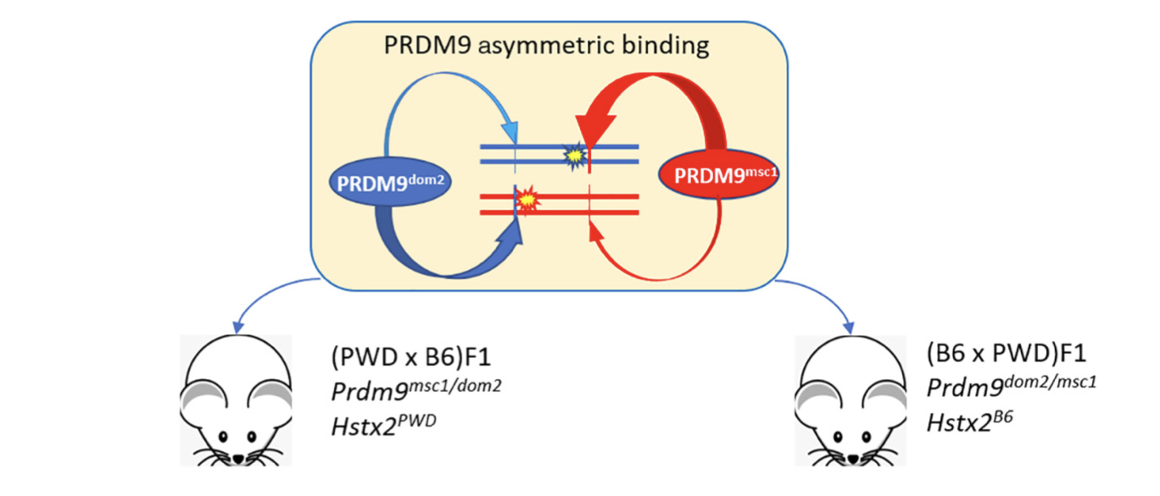
PRDM9 as a mammalian speciation gene
Speciation gene: a gene that induces hybrid incompatibility
Forejt et al., 2021

Slide 15
Explanation: PRDM9 binding symmetry couples DSB formation and repair
Pritchard, 2024

Slide 16

Evolutionary model of PRDM9 evolution driven by binding symmetry
Strong binding sites (hotspots) and weak binding sites
Binding sites compete for PRDM9 molecules
Bound PRDM9 molecules compete for DSBs
Fitness: probability of having a DSB at a symmetrically bound site
Baker, Przeworski and Sella, 2023

Slide 17
Two opposing effects
1. Competition for PRDM9: favors fewer hotspots to maximize symmetric hotspot binding
2. Competition for DSBs: favors more hotspots to maximize DSBs at hotspots vs. weak binding sites
Baker, Przeworski and Sella, 2023

Slide 18
How many hotspots are active in a diploid individual?
Heterozygotes: twice as many hotspots as homozygotes
Competition for PRDM9 favors homozygotes
Competition for DSBs favors heterozygotes
Which effect is more important?
Baker, Przeworski and Sella, 2023

Slide 19
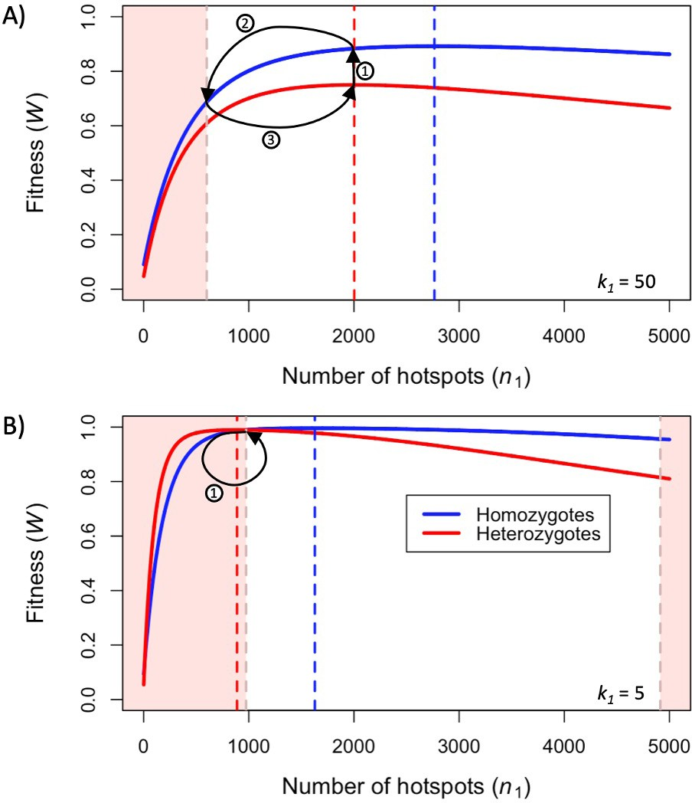
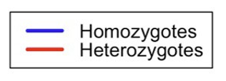
Hotspots are weak: competition for PRDM9 predominates
Baker, Przeworski and Sella, 2023

Slide 20
Hotspots are strong: competition for DSBs predominates
Baker, Przeworski and Sella, 2023

Slide 21
Finite population size: cyclic behavior under both regimes
Baker, Przeworski and Sella, 2023

Slide 22
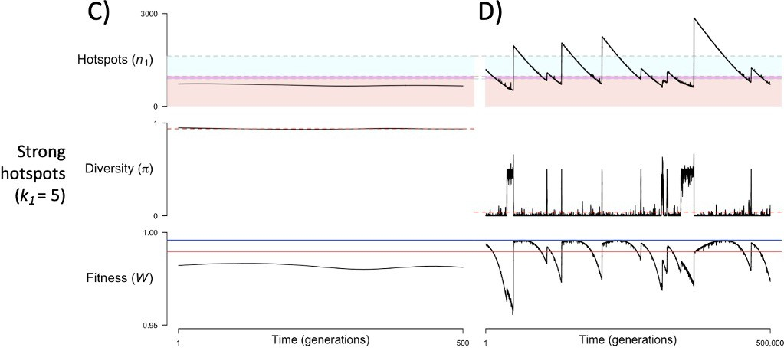
Finite population size: cyclic behavior under both regimes
Large N
Small N
Baker, Przeworski and Sella, 2023

Slide 23
Ascending and Descending, M.C. Escher, 1960

